Slide 1

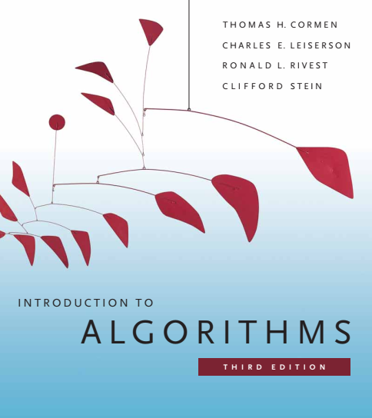
Design and Analysis of Algorithms
Dr. Sajid Iqbal
sajidiqbal.pk@gmail.com
Reference Book
Introduction to Algorithms 3rd Edition By Thomas H. Cormen et. al.
https://mitpress.mit.edu/books/introduction-algorithms-third-edition
COMEDXD

Slide 2
Perfect hashing
Chapter 11: hash tables

Slide 3
Introduction
The keys that we have to store in hashing table may be static or dynamic
Dynamic Keys: The keys which can be changed at program execution time
Static keys: The keys which remain unchanged throughout the execution of program
Usually hashing is considered good for excellent average case performance
Hashing can also perform excellent even in worst case when set of keys are static.

Slide 4

Perfect hashing
If a hash function requires $O(1)$ time for search in worst case.
To create perfect hashing, use two level of hashing
First Level: It is similar to hashing with chaining: hash the $n$ keys into $m$ slots using a hash function $h$
Second Level: Instead of using linked lists like chaining, use small secondary hash tables $S_{j}$associated with slot$j$ pointed by $h_{j}$
By choosing the hash functions $h_{j}$ carefully, we can guarantee that there are no collisions at the secondary level.
To guarantee that there are no collisions at the secondary level
Make the size $m_{j}$ of secondary table $S_{j}$be the square of the number $n_{j}$ of keys hashing to slot$j$ i.e. $m_{j}=n_{j}^{2}$.
By carefully choosing the first level hash function, the space required for secondary hash tables could be made $O(n)$

Slide 5
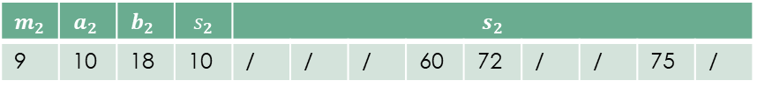
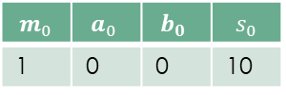
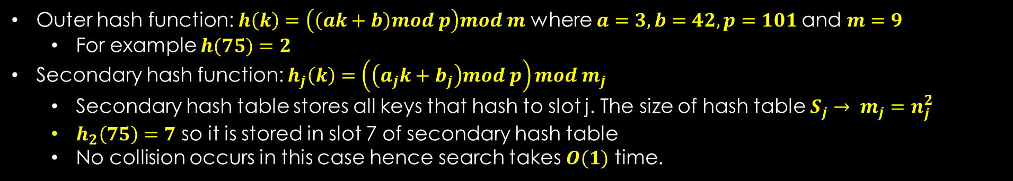

T
0
1 | /
2
3 | /
4 | /
5
6 | /
7
8 | /
K={
10,
22,
37,
40,
52,
60,
70,
72,
75}
$$m_{0}$$ | $$a_{0}$$ | $$b_{0}$$ | $$s_{0}$$
1 | 0 | 0 | 10
$$m_{2}$$ | $$a_{2}$$ | $$b_{2}$$ | $$s_{2}$$ | $$s_{2}$$
9 | 10 | 18 | 10 | / | / | / | 60 | 72 | / | / | 75 | /
$$m_{5}$$ | $$a_{5}$$ | $$b_{5}$$ | $$s_{5}$$
1 | 0 | 0 | 70
$$m_{2}$$ | $$a_{2}$$ | $$b_{2}$$ | $$s_{2}$$ | $$s_{7}$$
9 | 10 | 18 | 10 | / | / | / | / | / | / | 40 | 52 | 22 | / | / | / | / | / | / | / | 37 | /
Outer hash function: $h\left(k\right)=\left(\left(ak+b\right)mod p\right)mod m$ where $a=3, b=42, p=101$and $m=9$
For example $h(75)=2$
Secondary hash function: $h_{j}\left(k\right)=\left(\left(a_{j}k+b_{j}\right)mod p\right)mod m_{j}$
Secondary hash table stores all keys that hash to slot j. The size of hash table $S_{j}→ m_{j}=n_{j}^{2}$
$h_{2}\left(75\right)=7$ so it is stored in slot 7 of secondary hash table
No collision occurs in this case hence search takes $O(1)$ time.

Slide 6

Perfect Hashing
$𝓗_{pm}$: First level hash function where p is prime number greater than any key value. This function determines the master hash table slot
$h_{j}$: Rehash those hash keys which hash to slot $j$ into secondary hash table $h_{j}ε𝓗_{pm_{j}}$
The operation is performed in two steps
Determine how to ensure no collisions in secondary hash table
Expected amount of memory used for primary and all secondary hash tables is $O(n)$

Slide 7

Theorem 11.9
Statement:
Suppose we insert $n$-keys in hash table of size $m=n2$using a hash function $h$. The probability of collision of less than $1/2$
Proof:
There are $\left(\begin{matrix}n \\ 2\end{matrix}\right)=\frac{n!}{2!∗\left(n−2\right)!}$ pair of keys that may collide
Each pair collides with probability of $\frac{1}{m}$
Let $X$ be a random variable that counts the number of collisions
For $m=n^{2}$, expected number of collisions is
$E\left(X\right)=\left(\begin{matrix}n \\ 2\end{matrix}\right)∗\frac{1}{n^{2}}=$ $\frac{n!}{2!∗\left(n−2\right)!}∗\frac{1}{n^{2}}=\frac{n\left(n−1\right)}{2!}∗\frac{1}{n^{2}}=\frac{n^{2}−n}{2}∗\frac{1}{n^{2}}$
$E(X)=\frac{n^{2}−n}{2n^{2}}=\frac{1}{2}−\frac{1}{2n}<\frac{1}{2}$
A hash function chosen randomly from $𝓗$ is more likely to have no collision
For fixed number of keys it is thus easy to find a collision-free hash function $h$ with a few random trials

Slide 8

Perfect Hashing – Memory Usage
If n is large then use of one table will be inefficient. In this case two level of hash functions are used
$h_{2}(h_{1}\left(key\right))$
Overall memory used by perfect hashing is $O(n)$
For primary hash table, the size of table is $m=n$ so memory used is $O(n)$
What will be maximum size of secondary level hash tables.

Slide 9


Theorem 11.10
Statement:
Suppose that we store n keys in a hash table of size m D n using a hash function $h$ randomly chosen from a universal class of hash functions. Then, we have
$E\left[\sum_{j=0}^{m−1}{n_{j}^{2}}\right]$ where $n_{j}$ is the number of keys hashing to slot $j$
Proof:
We know that $a^{2}=a+2\left(\begin{matrix}a \\ 2\end{matrix}\right)$
$E\left[\sum_{j=0}^{m−1}{n_{j}^{2}}\right]=E\left[\sum_{j=0}^{m−1}{(n_{j}+2\left(\begin{matrix}n_{j} \\ 2\end{matrix}\right))}\right]$
$E\left[\begin{matrix}\sum_{j=0}^{m−1}{n_{j}}\end{matrix}\right]+2E[\sum_{j=0}^{m−1}{\left(\begin{matrix}n_{j} \\ 2\end{matrix}\right)]}$
$E\left[n\right]$ $+2E[\sum_{j=0}^{m−1}{\left(\begin{matrix}n_{j} \\ 2\end{matrix}\right)]}=n+$ $2E[\sum_{j=0}^{m−1}{\left(\begin{matrix}n_{j} \\ 2\end{matrix}\right)]}$
$\sum_{j=0}^{m−1}{\left(\begin{matrix}n_{j} \\ 2\end{matrix}\right)}$is the total number of pairs of keys in hash table that may collide
The expected value of this summation is at most $\left(\begin{matrix}n \\ 2\end{matrix}\right)∗\frac{1}{m}=\frac{n\left(n−1\right)}{2m}=\frac{n^{2}−n}{2m}=\frac{n−1}{2}$ as $m=n$
$E\left[\begin{matrix}\sum_{j=0}^{m−1}{n_{j}^{2}}\end{matrix}\right]≤n+\frac{2\left(n−1\right)}{2}$
$=2n−2$
$<2n$

Slide 10



Thanks for watching
Dr. Sajid Iqbal
Assistant Professor
Department of Computer Science
Bahauddin Zakariya University, Multan
sajidiqbal.pk@gmail.com
https://github.com/sajjo79/Design_and_Analysis_of_Algorithms
COMEDXD
Allah Hafiz

